Slide 1


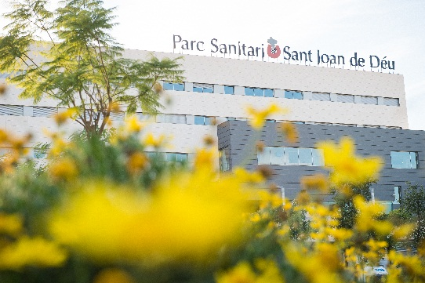

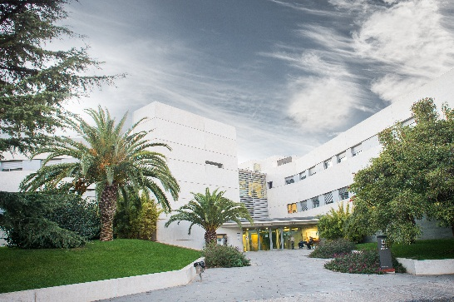
Workshop “Successfully
selling into NHS Wales”
February 18, 2016
www.pssjd.org

Slide 2

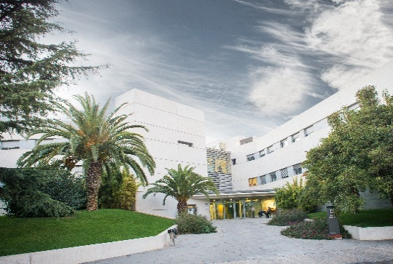
Who are we? Mission and Values Overview Governance Human Resources | Structural resources Activity Teaching and Research Quality and Safety Twinning
www.pssjd.org

Slide 3
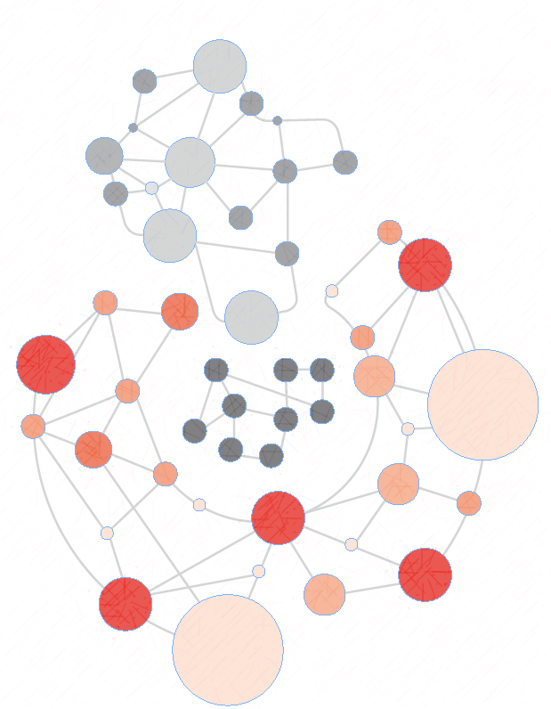

Who are we?
Títol
Parc Sanitari Sant Joan de Déu is an established trust of healthcare facilities, teaching and research, focused in two areas of expertise
Mental Health
Services
General
Hospital
Care

Slide 4

Our Mission and Values
Títol
A network of services that promotes the well-being and the independence of people by providing specialized and personalised health care and social services, while generating new knowledge that could improve the quality of life for the population.
Values of Sant Joan de Deu
Respect
Quality
Hospitality
Responsibility
Spirituality

Slide 5




Our Challenge: Vision 2020
Títol
Economically sustainable and that builds confidence
Improving the quality
and excellence
of health care
Collaboration in
the design of
public policies
Recognized by strong user orientation
Development
and coherent territorial presence
A Health and University organization

Slide 6
Governance
Títol
LEAD ENTITY
Community Board
GENERAL MANAGEMENT
Deputy General Manager
Steering committee
Communication
User Support Services
Technical Secretariat and
Management Control
Teaching, Research and Innovation
CEA SAER Volunteering Cooperation and Solidarity
Healthcare Operations Management
Support Area
Human Resources Management
General Hospital
Management
Nursing
Management
Mental Health
Management
Economic and Financial Management
Information Systems Management
Quality and Patient Safety
Programs
Patient Management
Engineering and General Services Management

Slide 7


Human Resources
Healthcare Staff
Total number of
Parc Sanitari Professionals :
Senior Management 345
Middle managers 480
Technical or Vocational training 610
1,975
Support Staff
1,385 women
Senior Management 12
Middle managers 25
Technical or Vocational training 245
590 men

Slide 8





Operational Resources
Títol
Psychiatric hospital
Hospitalization Area
Maternal
20
Acute, sub acute, SERPI
Intellectual
Disability
Psychogeriatrics
Traumatology
40
344
141
59
Emergency Area
Medical specialities
72
Therapeutic
Community
Home Residence
Box 50
Pediatrics
12
Other surgical specialities
48
21
18
Convalescence
20
29
Emergency hospitalization
Correctional psychiatric hospitalization
Acute, sub acute, medium stay and Mille
Psychiatric
nursing
Therapeutic Juvenile
Justice Unit
Surgical Area
124
66
12
Total operating rooms
UCSI
6
8
Community Area
Mental health
Center
Day
Hospitals
Community
Rehabilitation Services
Community Rehabilitation Services and Labour integration
Palliative Care Unit
Ambulatory area
Consulting rooms
Cabinets
10
47
11
8
4
7
1
Pre-labour
Service
Assisted
Flats
Occupational Center
Specialized Mental health
Service (DI SESMDI)
Obstetric area
Intensive Care Unit
Labour and delivery
rooms 5
In operation
9
1
6
1
2

Slide 9

Reference population
Mental health
General Hospital
Ambulatory mental health services
All the specialities
126,445 inhabitants
672,967 inhabitants
Maternal and child health, vascular surgery and convalescence
Acute hospitalization
633,710 inhabitants
309,470 inhabitants
Psychiatric Day hospital
1,364,085 inhabitants
Psychiatric Emergencies
732,024 inhabitants
Medium and long stay hospitalization
1,047,433 inhabitants
Community Rehabilitation Service
791,991 inhabitants
Sub acute hospitalization
931,815 inhabitants
Intellectual Disability
It has no reference population. These patients are managed through a centralized list at a Catalonia level, even though depending on needs, it tries to prioritize nearest areas, except in the case of SESM-DI, which covers a population of 2,492,731 inhabitants.

Slide 10
Activity Overview for 2014
HOSPITALIZATION
12,931 Discharges
TOTAL EMERGENCIES
88,465 Medical visits
Walk-In
177,712 Medical visits
8,814 Day Hospital Sessions
7,840 Ambulatory Surgery
SOCIAL AND HEALTH CARE
3,494 Stays in the Palliative Care Unit
9,350 Stays in Convalescence
PSYCHIATRIC HOSPITALIZATION
1,421 Discharges in Acute + Sub acute
75 Discharges in Therapeutic Community
83,895 Long Stay (High Psychiatric Unit + Severe Mental Disorder)
7,282 UAPE stays
21,325 Psychogeriatrics Long Stay
299 Day Hospital Discharges
COMMUNITY SERVICES
171,780 Visits - Adult Mental Health Centers
213 Day Center Discharges
INTELLECTUAL DISABILITY
9,968 SESM-DI Visits

Slide 11






Investing in knowledge
Research groups
Specialized medical training
Multi professional Teaching Unit of Mental Health
Etiopathogenesis and treatment of severe
mental disorders
Teaching Unit Associated to Sant Joan de Déu Hospital of Surgery in Esplugues
Health technologies and results in primary care
and mental health (PRISMA)
Teaching Unit Associated to Costa Ponent of Family Medicine and Community
Research and innovation in surgery
Sant Pere Claver Teaching Unit Associated to Parc Sanitari Sant Joan de Déu
Associated Unit to Sant Joan de Déu Hospital of Gynecology and Obstetrics in Esplugues
Impact, risk and prevention of mental disorders and aging
Clinical and epidemiological research in major diseases

Slide 12
Quality and Safety Strategic Plan. 2012-2016
. Organization and structure in place to develop goals
. Standardisation of clinical practice
. Workflow processes
. Improvement projects related to Q&S incidents
CARE
FOCUSED ON
PATIENTS
. Healthcare improvement groups
. Clinical leadership
. Communicate / Culture Q&S
. Train professionals
QUALITY
EFFECTIVENESS
SAFETY
. Declaration and analysis of incidents
. Review of complications
. Audits (operating room check list, identification, hand-washing. ..)
. Quality and Safety Scorecards
(2 levels: managers and heads of service)
MONITORING AND EVALUATION

Slide 13
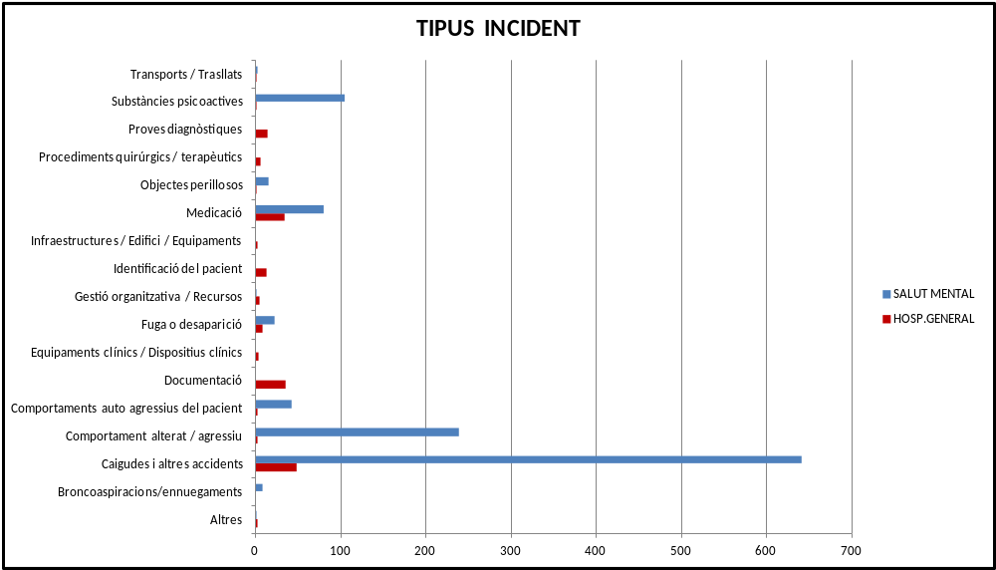
Patient Safety monitoring

Slide 14
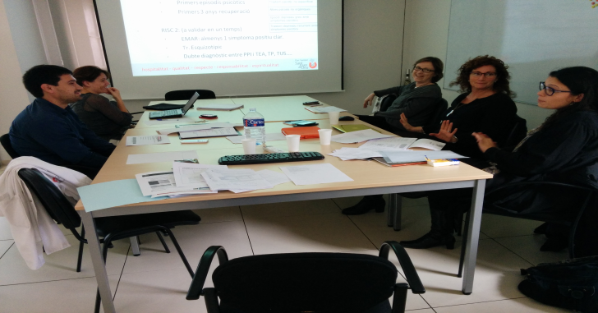
The Quality Improvement Approach
Act
Plan
Meeting Room
Study
Do
APPROVE IF NECESSARY
DESIGN
Real World
TEST & MODIFY
TEST & MODIFY
TEST & MODIFY
START TO IMPLEMENT

Slide 15
Examples of Quality Care Projects
Focus Areas | Actions
Mental Health Accreditation (EFQM) | Design processes Establishment standards Establishing indicators
Clinical Practice Improvement | “Do not do” Identify inefficiencies Restructuring of chronicity and social care Rearrangement of long stay psychiatric care
Patient Safety | Incidents declaration Complications detection Audits and Processes Risk prevention / improvements
Monitoring and Evaluation | Scorecards at three levels: Board, Senior Managers and Service Heads
Territorial Alliances | Cancer care program
Health programs | Chronic Complex Patient Psychosis first episode Home Care
Technology assessment | Workgroup Technologies General Hospital

Slide 16
Q&S incidents – Examples of Making improvements
Area of work | Activity
HUMAN RESSOURCES | Review skills of staff in critical areas
DEVELOPMENT WORKFLOW PROCESSES | Pathway identification of the patient in emergency, admissions and outpatient units Verification of the check-list for safe surgery Ortogeriatrics
TRAINING | Control of infections Prevention of falls Research of “evidence based” literature Quality and Safety Online
IMPROVEMENT GROUPS | Group improved handling of new anti-coagulants Group improved surgical infection of the colon Psychosis workflow
ORGANIZATION CHANGES | New alert system CPR New notification system of Security Incidents New review system of complications and mortality

Slide 17

Quality and Safety Bulletin: dissemination of knowledge

Slide 18



Accreditation: EFQM Model
AGENTS FACILITATORS
RESULTS
Persones
Resultats en les persones
Política i estratègia
Resultats en
Resultats
Lideratge
Processos
els clients
clau
Aliances i
recursos
Resultats en
la societat

Slide 19
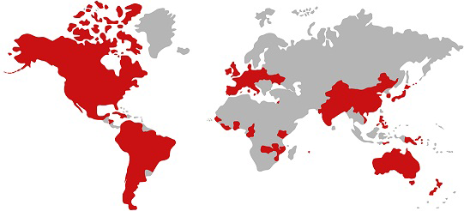
X. Twinning
At present, the Parc Sanitari Sant Joan de Déu is twinned with:
Dalai Center FATICK Xelde Senegal Thies
San Juan de Dios hospital in La Habana (Cuba)
In both centres there has been an analysis of the situation, from a global perspective of the centre, including a SWOT, definition of strategic lines and actions.
518
The areas where they are developing this partnership are:
Continuous training of professionals
Techniques in making and / or developing protocols and methodology
Information systems
Professional exchange

Slide 20
Thank you for your attention
www.pssjd.org

